Slide 1
MS Excel
Presented by Manal Asghar

Slide 2
VLOOKUP & HLOOKUP
VLOOKUP: searches vertically in the first column.
Syntax: =VLOOKUP(lookup_value, table, col_index, FALSE)
HLOOKUP: searches horizontally in the first row.
Syntax: =HLOOKUP(lookup_value, table, row_index, FALSE)

Slide 3
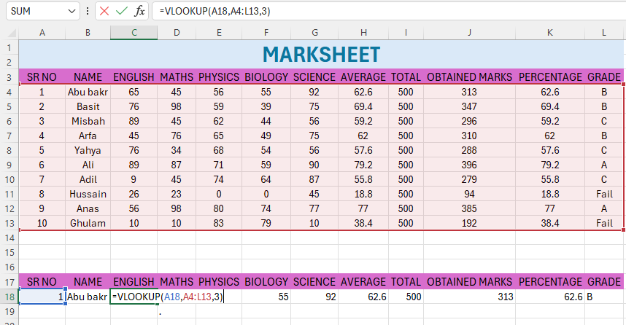

Slide 4
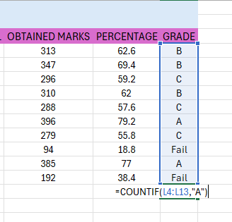
COUNTIF, SUMIF, AVERAGEIF
COUNTIF: =COUNTIF(range, criteria) → Counts matching cells.

Slide 5
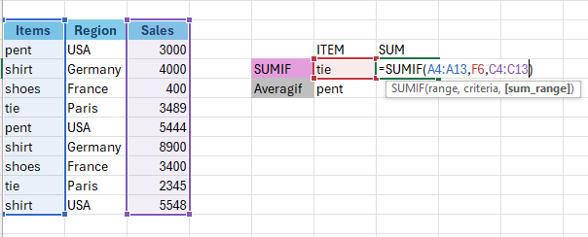
SUMIF: =SUMIF(range, criteria, sum range) → Sums matching.
SUMIF

Slide 6
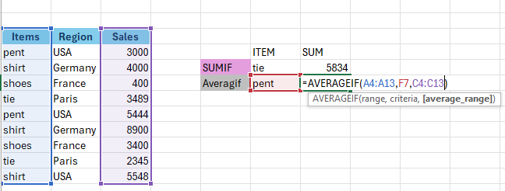
Average IF
AVERAGEIF: =AVERAGEIF(range, criteria, average,range) → Averages matching

Slide 7
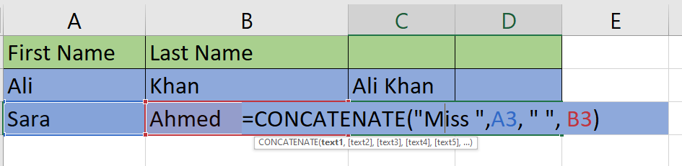
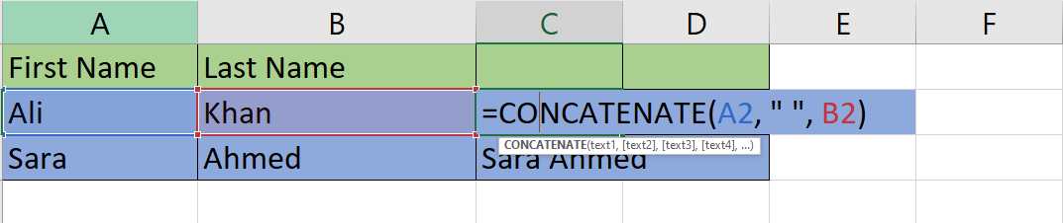
What is CONCATENATE in Excel?
Concatenate (Or Its Newer Version Text join / Concat) Is A Function Used To Join (Combine) Text From Multiple Cells Into One String.

Slide 8
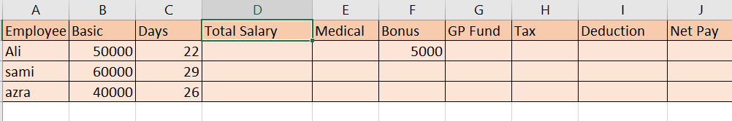

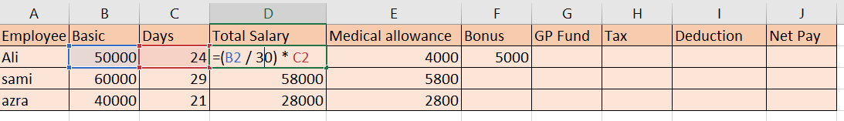
Payroll sheet in excel
For basic salary

Slide 9
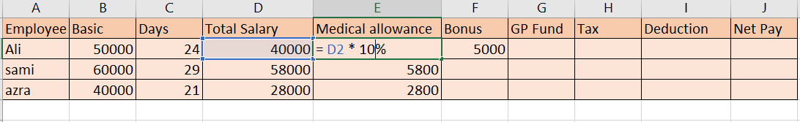
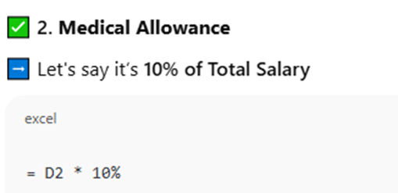
For medical allowance

Slide 10
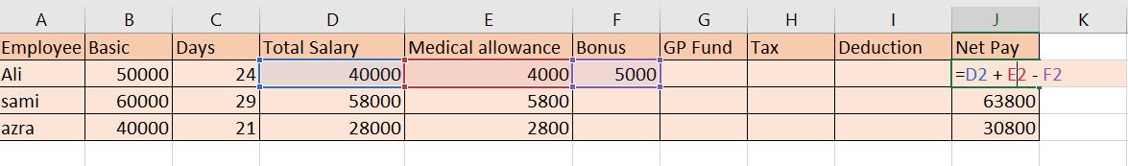
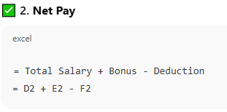
For net pay

Slide 11
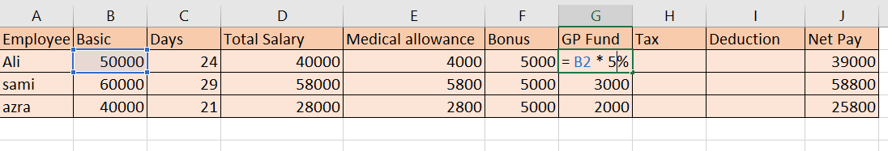
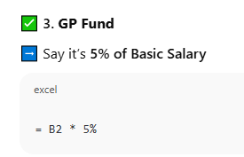
GP funds

Slide 12
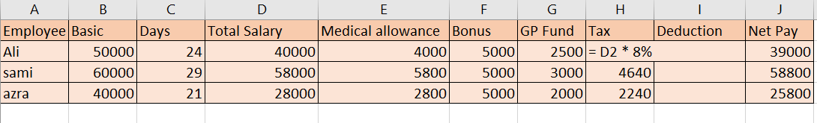
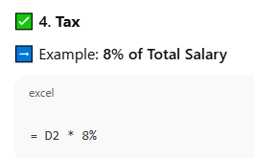
for Tax

Slide 13
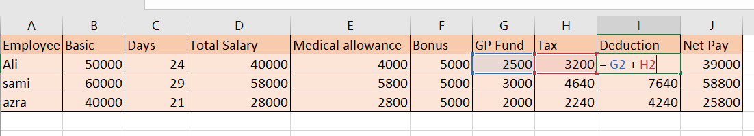
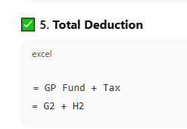
For deduction

Slide 14
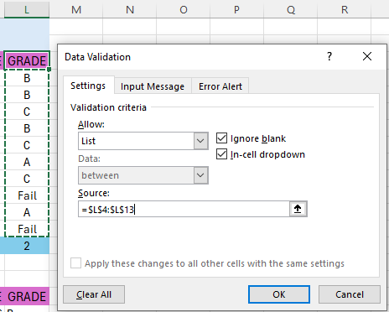

Data Validation
Data Validation
Restricts user input.
Example:
Create dropdown for Grade
(A, B, C, D, F)
Data tab → Data Validation → List

Slide 15
Data sorting and filtering
Sorting
Arrange data A-Z / Largest to Smallest.
Filtering
Display specific records only.
Data → Filter

Slide 16
Protect Workbook
File then protect workbook
Encrypt with password
Type password

